Slide 1
MANHOLE MONITORING
SYSTEM
PRESENTED By : S.BALAJI(22AI003) S.NARESH KUMAR(22AI027) K.SRIJITH(22AI051)​
​
Guided By :Dr.K.Lalitha
TEAM NO
COURSE CODE &COURSE TITLE

Slide 2
Abstract
The manhole monitoring system aims to enhance urban infrastructure management by providing real-time surveillance and data analysis of manholes, addressing safety concerns.
This system aims to improve safety, optimize maintenance, and prevent infrastructure failures by detecting critical issues such as hazardous gas levels, and temperature level, fire aleart.​

Slide 3
Objectives:
Detect hazardous gas levels, water overflows, temperature, fire and unauthorized access in real-time to prevent accidents and ensure public safety.​
Provide real-time data and alerts to maintenance teams ​
remotely, reducing the need for manual inspections and ​
improving efficiency.​
Use data analytics for predictive maintenance, reducing operational costs and ensuring timely repairs based on actual conditions.

Slide 4
Components Required:
LCD display
Switch
Buzzer
Gas Sensor
Water Level Sensor
Temperature Sensor (DHT11) Arduino UNO​
ESP8266 Wi-Fi Module or SIM800L GSM Module ​​ ​

Slide 5
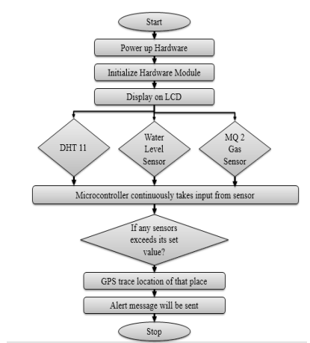
Flow Diagram:

Slide 6
Implementation: Hardware:
Assemble Sensors and Microcontroller: Connect the gas sensor (MQ-4/MQ-7), water level sensor (HC-SR04), and temperature sensor (DHT11/DHT22) to the microcontroller (ESP32 or Arduino). For Arduino, add the ESP8266 Wi-Fi module for internet connectivity or SIM800L for SMS alerts.
Power the System: Use a 9V battery or 18650 lithium-ion battery with a charging module (TP4056) to power the microcontroller and sensors.​
Mount and Test: Place the system in a waterproof enclosure, expose the sensors, and test by varying gas levels, water levels, and temperature, checking data on a serial monitor.​

Slide 7
Implementation: Software:
Program the Microcontroller: Use Arduino IDE to write the code. Install libraries for sensors (Adafruit DHT for temperature, NewPing for water level, MQUnified for gas). Write code to read sensor data (temperature, humidity, gas) and send it via Wi-Fi.​
Connect to the Cloud: Use Wi-Fi (ESP32/ESP8266) or SIM800L to send data to ​cloud platforms like ThingSpeak or Blynk​
Set Up Data Visualization: Create real-time dashboards on ThingSpeak orBlynk ​to visualize the sensor data and track trends. Use SMS or push notifications for ​alerts when thresholds are breached.​

Slide 8
THANK YOU

